Slide 1
HYPTHESIS TESTING
Class Notes by A.Sandanasamy, BHC, Trichy 17

Slide 2
Hypothesis testing is the procedure used in inferential
statistics to estimate population parameters based on sample data.
Sample Research Question
Test of reading comprehension for fourth graders is normally distributed
with μ = 70 and σ = 10.
A random sample of n = 25 fourth graders are taught the technique and then
tested for reading comprehension.
sample mean of M = 75 is obtained.
Does the sample mean (M) differ enough from the population mean (μ)
to conclude that the reading technique made a difference in level of
comprehension?

Slide 3
HYPOTHESIS TESTING STEPS
1. Formulate hypotheses.
2. Indicate the alpha level and determine critical values.
3. Calculate relevant statistics.
4. Make a decision and report the results.
Class Notes by A.Sandanasamy, BHC, Trichy 17

Slide 4
Step 1: Formulate Hypotheses
There will be two mutually exclusive hypotheses:
Either the new reading technique does not have an effect on comprehension, or it does.
Both cannot be true.
These competing hypotheses are referred to as the null hypothesis and the alternative hypothesis,
respectively.
The null hypothesis (symbolized by H0) attributes any differences between our obtained sample mean and the population mean to chance.
• chance (i.e., any differences found are simply due to chance, or random sampling error)
• equality (i.e., there is no true difference between our obtained statistic and the
population parameter being predicted; they are essentially equal)
• ineffective treatment (i.e., the independent variable had no effect)

Slide 5
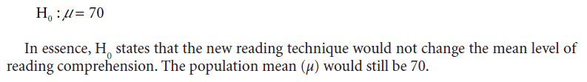
The alternative hypothesis (symbolized by H1), also called the research
hypothesis, is the opposite of the null.
H1 describes
• true differences (rather than just chance differences)
• the effectiveness of treatment (of the independent variable)
Class Notes by A.Sandanasamy, BHC, Trichy 17

Slide 6

The alternative hypothesis, on the other hand, states that the new reading
technique does have an effect on comprehension and that differences between M and μ are more than chance differences.
Class Notes by A.Sandanasamy, BHC, Trichy 17

Slide 7
Directionality of the Alternative Hypothesis
A nondirectional alternative hypothesis merely states that the value of μ
is something other than the value predicted in H0; the direction of expected differences is not specified.
A directional alternative hypothesis specifies the direction of expected difference and is used when researchers have reason to believe that a
treatment will either increase or decrease a mean score.

Slide 8
Thus, H1 could alternatively be written as
• H1: μ ≠ 70 (nondirectional)
• H1: μ > 70 (directional)
• H1: μ < 70 (directional)
first case (H1: μ ≠ 70),
the alternative hypothesis predicts that the mean of the population would not equal 70 after use of the new
reading technique.
second case (H1: μ > 70), the alternative
hypothesis predicts that the mean of the population would increase after use of the new reading technique.
third case (H1: μ < 70) predicts that μ would decrease

Slide 9
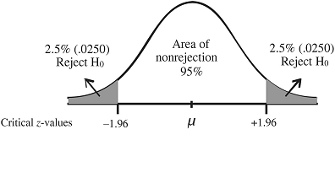
Step 2: Indicate the Alpha Level and Determine
Critical Values
The alpha level (symbolized by α) is a probability level set by the researcher that defines the point at which H0 should be rejected.
Most often, the alpha level is set at .05 or .01, and occasionally at .001.
The critical region is the area of a sampling distribution in which score outcomes are highly unlikely (i.e., have a low probability of occurrence).

Slide 10
Sample means that fall in these areas have a 5% or less likelihood of occurring
by chance alone if H0 is true.
This low probability makes H0 unreasonable enough to be rejected.
The critical values of ±1.96 separate these regions of rejection from the rest of the distribution.
Class Notes by A.Sandanasamy, BHC, Trichy 17

Slide 11
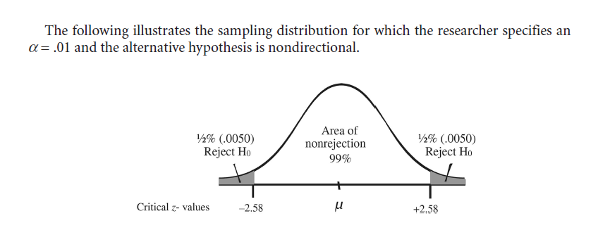

Slide 12
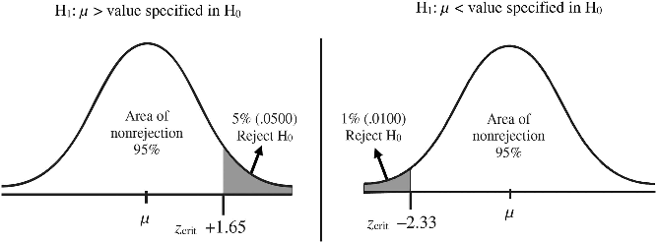
If a directional alternative hypothesis is specified, the entire rejection
area is contained in one end of the distribution.
If H1 specifies that μ would be greater than (>) a particular value, then
the rejection region would be in the right tail only.

Slide 13
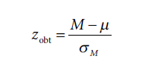
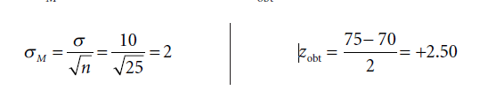
Step 3: Calculate Relevant Statistics
It was reported earlier in our research question that our obtained mean
for a sample of n = 25 fourth graders was M = 75 after they were taught
the new reading technique. A σ = 10 was also reported.

Slide 14
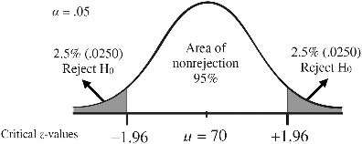
Step 4: Make a Decision and Report the Results
Finally, we must decide whether to reject the null hypothesis that H0: μ = 70. We are using an α = .05 and a nondirectional alternative hypothesis.
Class Notes by A.Sandanasamy, BHC, Trichy 17

Slide 15
For our example, the zcrit values are ±1.96, meaning that in order
to reject H0, we would need a sample mean that converted to an obtained z-value beyond 1.96 (in either direction).
Our obtained z-score was +2.50, which falls in the rejection region.
Thus, we will reject H0: μ = 70.
Results Format
The new reading program had a significant effect on reading comprehension.
Reject H0, z = +2.50, p < .05.
Class Notes by A.Sandanasamy, BHC, Trichy 17

Slide 16
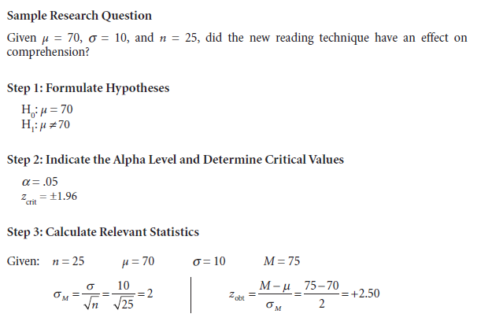


Slide 17
Hypothesis Testing with the z-Test
Research Question.
A standardized productivity scale has a μ = 25 and a σ = 5. The CEO of
Company A wants to know if employee participation in company decisions has an effect on productivity. A sample of n = 75 employees who
participated in the decision making process was administered the
productivity scale with a result of M = 27.
Does participation in company decisions have an effect on productivity?
Use α = .01 and a two-tailed test.

Slide 18
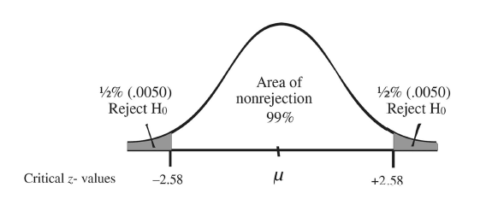

Slide 19
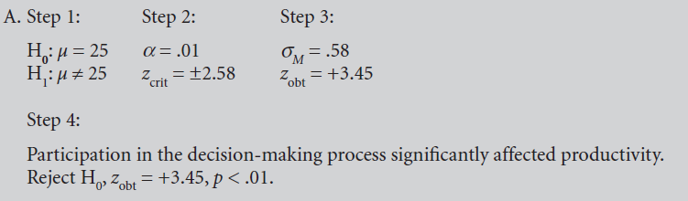

Slide 20
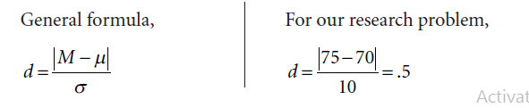

EFFECT SIZE FOR A Z-TEST
Effect size indicates the magnitude of a treatment effect.

Slide 21
ASSUMPTIONS
Statistical procedures that test hypotheses about populations are referred to as parametric tests.
Such tests should live up to certain assumptions in order for the results to be
well founded. The general assumptions for the z-test are as follows:
Independent and random selection of participants.
Normality: This is necessary because we are using the normal distribution
table
Interval or ratio scores: A mean cannot be calculated for nominal or ordinal-level data.
σ is known.

Slide 22
ERRORS
Hypothesis testing involves making a decision to either reject the null hypothesis or not to reject it.
However, we can also be either right or wrong in our decision to reject or not to reject.
That is, the null hypothesis could really be true and we could reject it, which would be an error.
Alternatively, the null hypothesis could really be false and we could fail to reject it –
also an error.
A Type I error is rejecting a null hypothesis that is in reality true.
A Type II error is the failure to reject a null hypothesis that is in reality false
Class Notes by A.Sandanasamy, BHC, Trichy 17

Slide 23
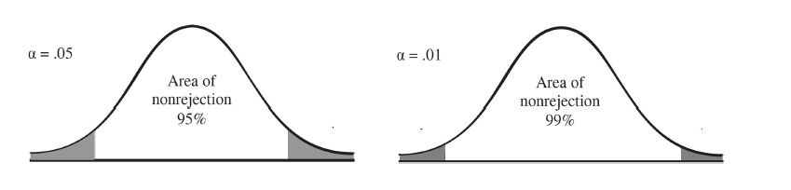
Using α = .01 reduces the rejection region and we would therefore be
rejecting H0 less often.
using α = .01 rather than α = .05 simultaneously increases the probability of a Type II error .

Slide 24
POWER
The power of a statistical test refers to its ability to reject a null hypothesis that is in fact false.
In other words, power makes it more likely that a treatment that actually exists
will be detected.
Alpha Level:
Choosing a less rigorous alpha level, such as .05 instead of .01, will increase power, making it more likely that the null hypothesis will be rejected.
However, keep in mind that this will also increase the likelihood of a Type I error
Directionality of the alternative hypothesis.
A similar case can be made when discussing a one- or two-tailed test.
Other things being equal, a one-tailed test is more likely to detect statistical significance
because the rejection region is larger. If α = .05, the rejection region encompasses the
entire 5%.

Slide 25
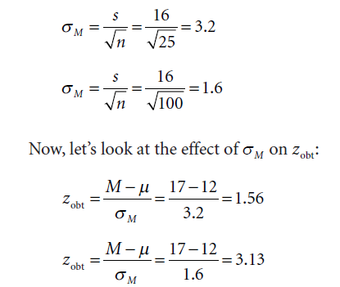
Sample size.
Reduced sampling error will result in larger obtained test statistics.
To illustrate, let’s look at the example with the same standard deviations but with
different sample sizes:

Slide 26
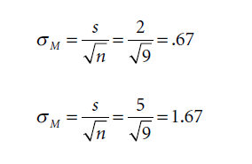
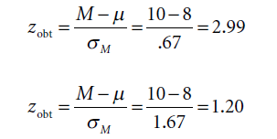
Variability of the data.
We have learned that the standard deviation is a measure of the variability of scores.
Greater variability increases the amount of standard error making rejection of the null
hypothesis less likely.
Class Notes by A.Sandanasamy, BHC, Trichy 17

